Slide 1
Text Data Visualisations
CorrelAid X Austria
Tilman Kerl

Slide 2

Who Am I?
Tilman Kerl
Master Data Science @ TU Wien
Computer Science @ Uni Konstanz
CorrelAid since 2019
Thesis on Visual Analytics for Transformer models
I own very fashionable hats
(and I don’t know where to put my hands during photos)

Slide 3
Scope & Agenda for today
Text & Language
Why is it important?
What is it?
Why is it difficult to work with?
Visualizing Text
What is possible
Feature Extraction
Code Examples
Notes:
A intro & give overview and pot. spark interest as the whole topic is way to much for it to fit in a 40 min slot

Slide 4

Who are you?
Slido: What is your background?
http://bit.ly/3FanvjI
Notes:
Results -> problem with similar words

Slide 5
Part 1
What is Language
and Text?

Slide 6

Why is text data important?
Text data is everywhere: Reviews, Social Media, Newspaper, Chats, Political documents
We communicate with text
There is (most of the times) a lot of information in text data about
what we want
how we feel
how we think
potential plagiasm
….
Notes:
How does text and language changes over time
Understand and map cultural differences in language

Slide 7
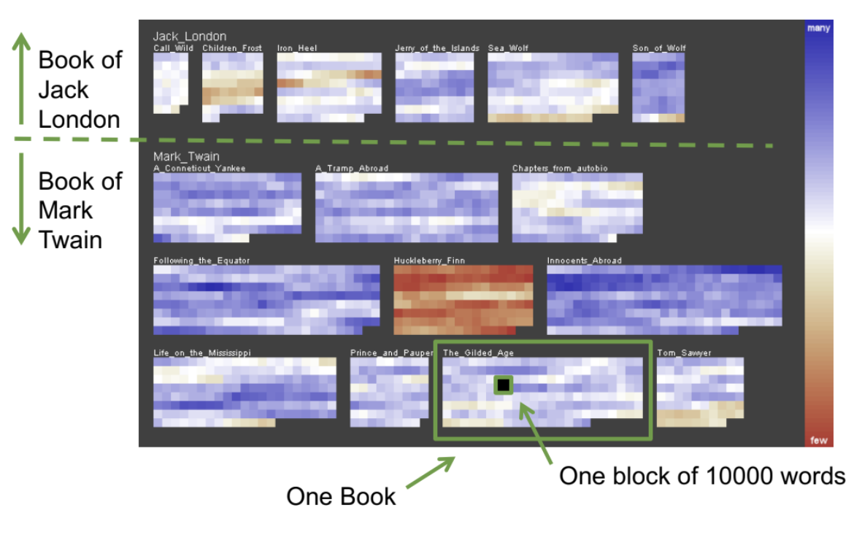
Example Use Case: Literature Fingerprinting
characterize a text and a writing style
assign and obtain “fingerprints” of an author
Authorship Attribution
Plagiarism Checks
We can spot differences between the two authors
Something special about “The Adventures of Huckleberry Finn” → Reason unclear, maybe Ghost Writer?
See: Literature Fingerprinting: A New Method for Visual Literary Analysis: https://ieeexplore.ieee.org/abstract/document/4389004

Slide 8
What is text?
Notes:
Brainstorm -> input unstructured, collection of words (tokens), Phonetics (physical entities), Syntax, Semantics, Phonology (sound as part of grammar)

Slide 9
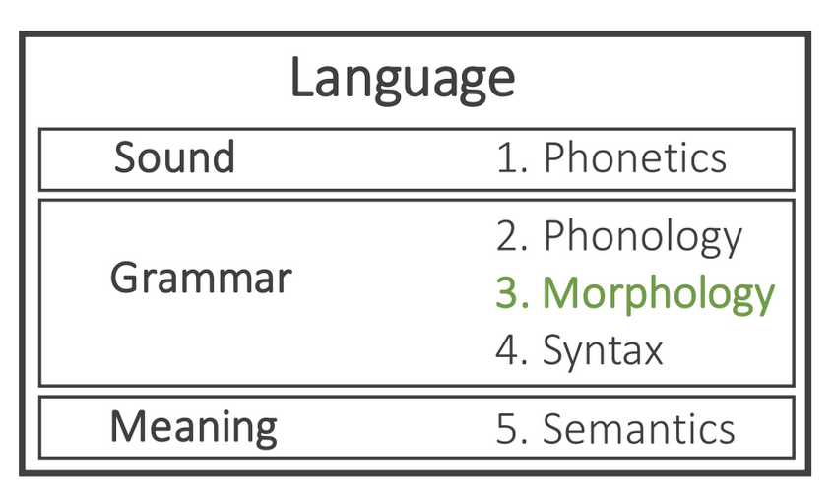
What is language?
Morphology
The study of the way words are built up from smaller meaning units
Morphemes
The smallest meaningful unit in the grammar of a language
Root, Stem, Lemma
Stemming & lemmatization
morphy() vs. Porter Stemmer
Different Approaches to the problem

Slide 10
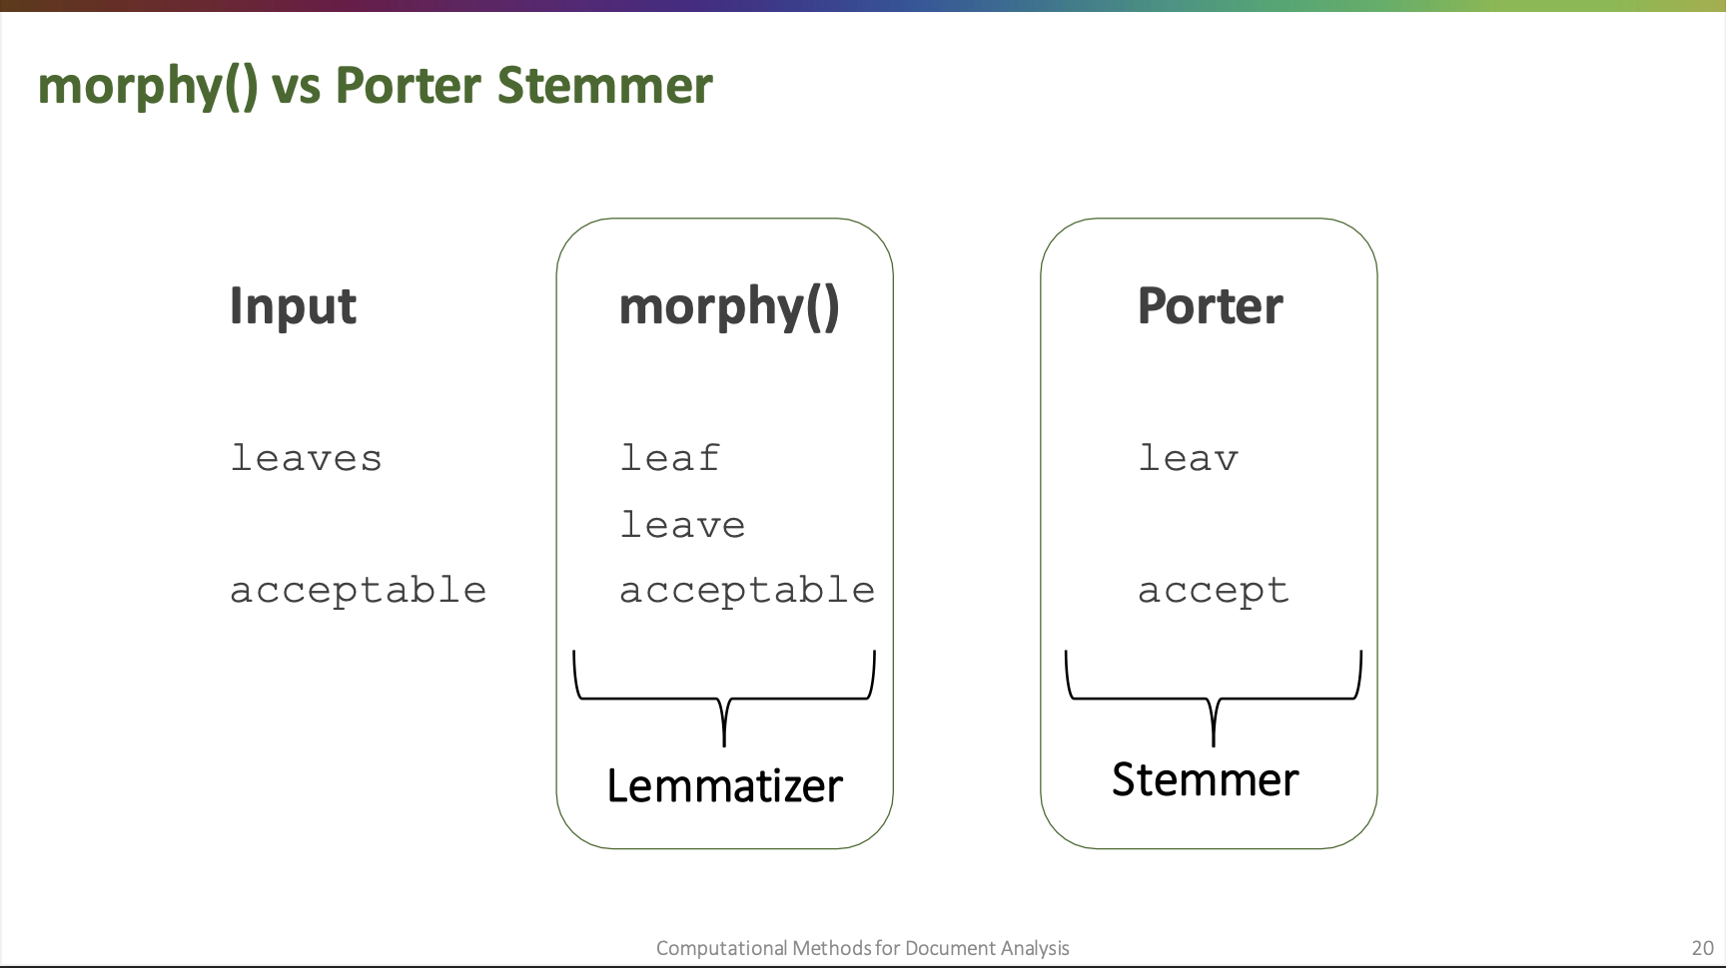
Prof. Daniel A. Keim, Uni Konstanz, 2019
* Slide from the Computational Methods for Document Analysis by Prof. Daniel A. Keim, University Konstanz (2019)

Slide 11
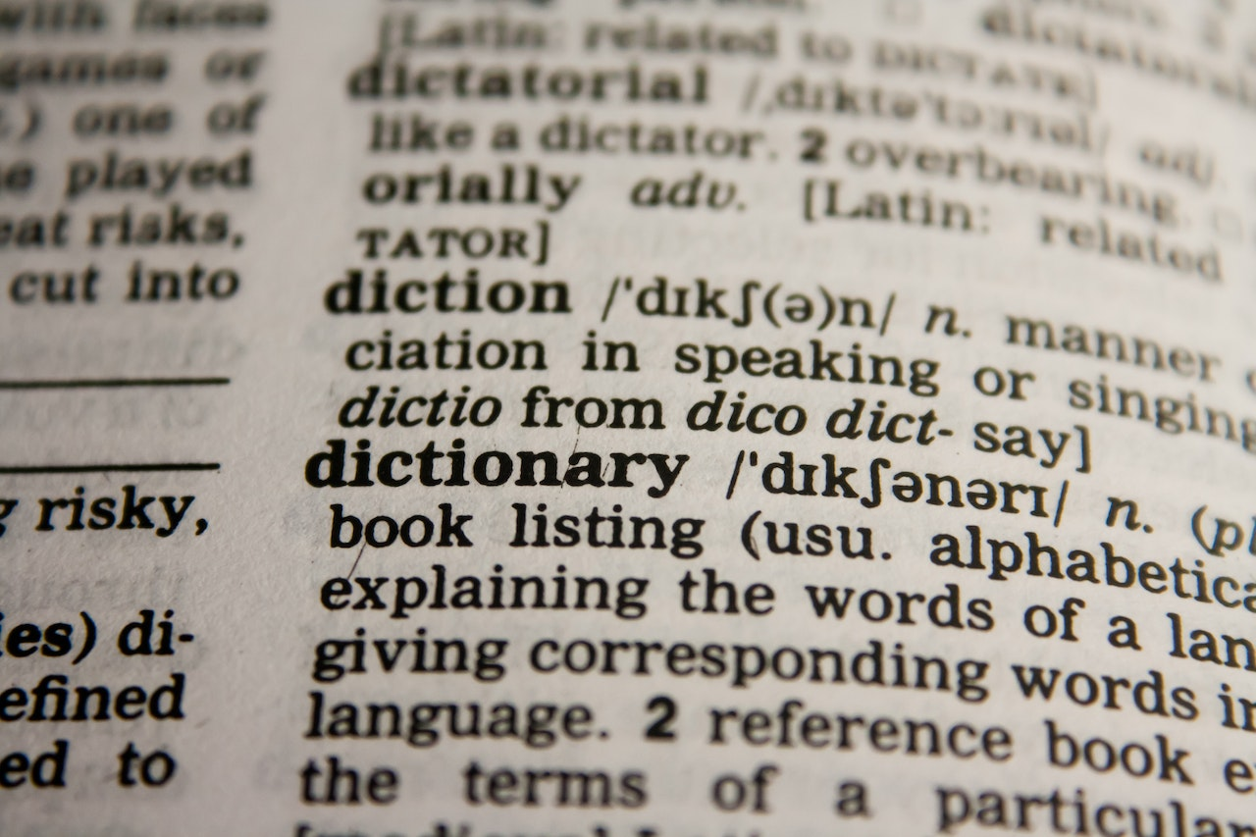
Why is text so difficult to work with?
Language has multiple layers which are difficult to understand for machienes
Working, worked, works refer to the same action but are different words (stemming)
Human concepts as sarcasm and irony are hard to grasp, even for humans sometimes
How we percive text and spoken language is also influenced by our mood (“Just relax”) --> the same sentence or word can have multiple meanings
Punctuation matters (Let’s eat (,) grandpa)
Context matters
We have 100+ languages
Notes:
Not pre-attentive
High dimensional

Slide 12
Part 2
Visualizing Text

Slide 13
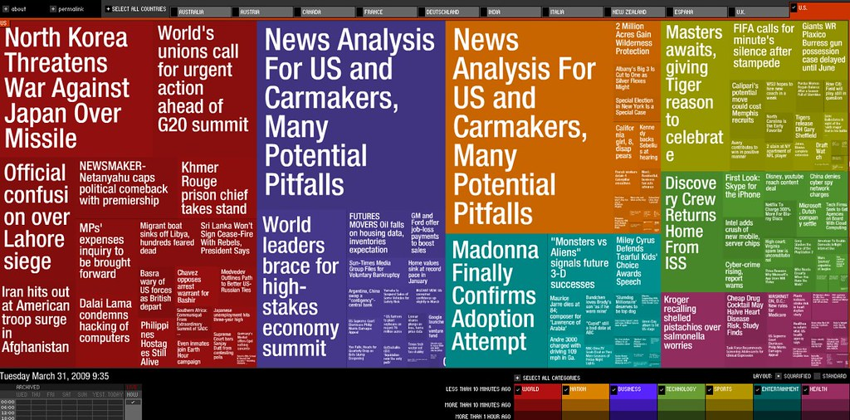
How can we visualize text data?
Text itself has limits on how we can visulize it
Some basic visualizaitons include:
Keywords over time
Wordclouds
Newsmaps (Treemap)
Most visualisations need extracted features
Notes:
Newsmap -> color is a topic with differetn stories
Big one is main one with smaller ones corresponding to the bigger one

Slide 14

What features can be extracted?
Basics informations
Term frequency (see Zipfs-Law)
Token-relationships
POS-Tags
Dependencies
Co-occurence
Token/Phrase simililarity
Levenstein distance
Embedding distance
Word Embeddings
Word2vec (Context independent model)
Context dependent models via Language Models (esp. transformer models like BERT)
Advanced Features
Sentiment, Topic, Entities , …
Notes:
Zipf's law states that the frequency of a token in a text is directly proportional to its rank or position in the sorted list.
POS-tags: grammar class
Which features we need and want and make sense are task depdented

Slide 15
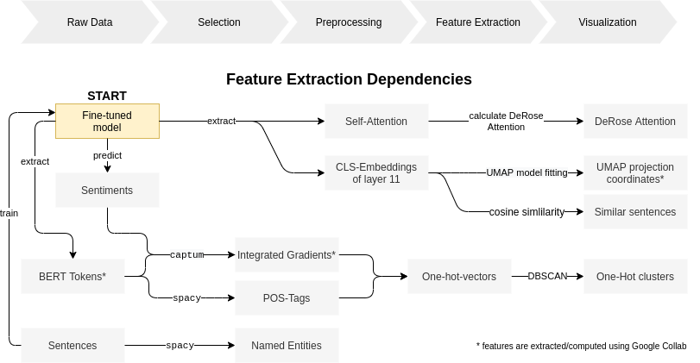
Text Analysis Pipeline

Slide 16
Text Analysis Pipeline
Common Preprocessing Steps
Basic cleaning like: new-line and whitespace removal
Stop-word removal
Stemming
Sentence detection
Tokenization
POS-Tagging
…

Slide 17

(Contextualized) Language Models - Transformer
Recent (2017) developments: transformer and attention
STAR choice for NLP task over RNNs
strong models like BERT & GPT-3
Statistical representation of langugage
Somewhat understaning of Language & Context
Applicable for all common text analysis tasks like Text Classification (e.g. Sentiment Analysis), Text Generation, Question Answering, ….
Notes:
for those of you who are familiar with transformers, you probably have
already seen this image, for those who don't know what I am talking about
transformers are a deep learning model presented in 2017
designed for sequential data
They initially have been designed for translation but can be used for any NLP task
they build on attention mechanics as have been already used in RNN, LSTM.
But they say "attention is all you need" to achieve the performance of rnns.
Further transformer facilitate parallelization
and thus training on larger corpuses.
This then made pre-trained models like google's BERT or
openAi's GTP-3 possible (conceptually different, but not into detail here)

Slide 18
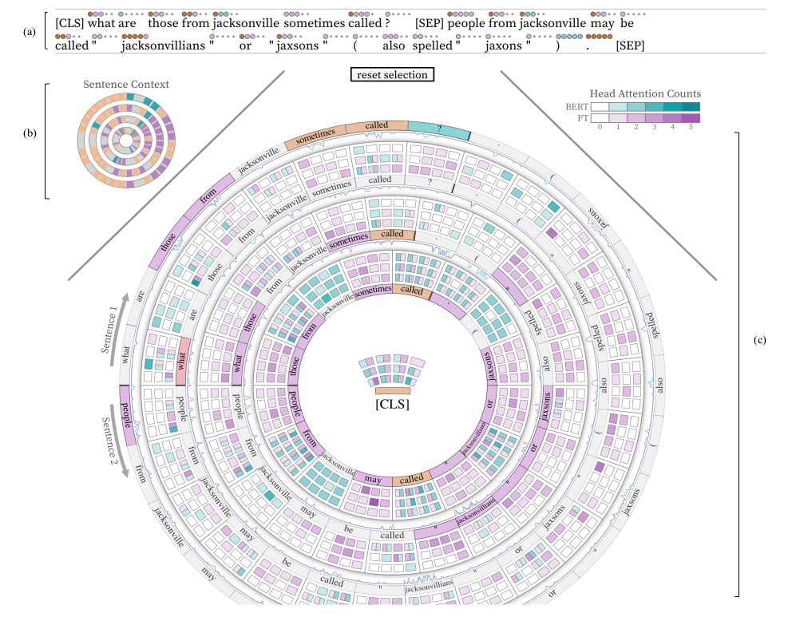
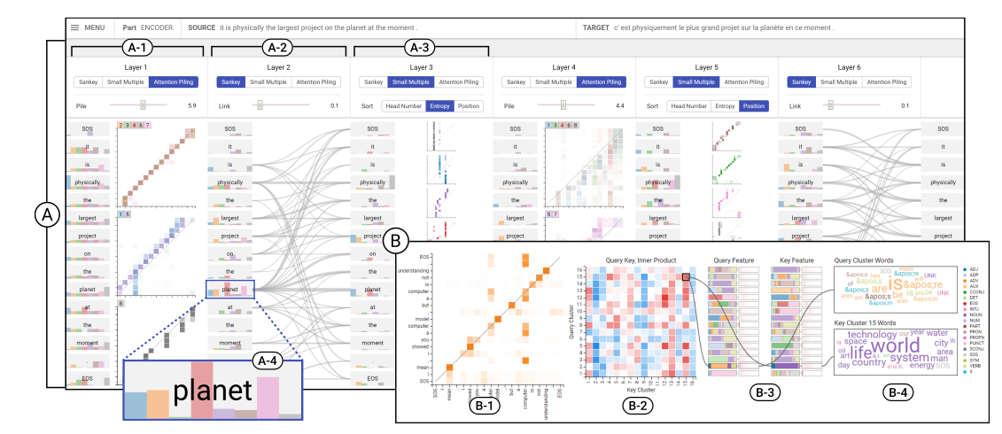
Text Visualizations in Research (XAI)
Fig 1 from: Joseph F. DeRose, Jiayao Wang, and Matthew Berger. 2020. Attention Flows: Analyzing and Comparing Attention Mechanisms in Language Models. abs/2009.07053 (2020). arXiv:2009.07053 https://arxiv.org/abs/2009.07053
Cheonbok Park, Jaegul Choo, Inyoup Na, Yongjang Jo, Sungbok Shin, Jaehyo Yoo, Bum Chul Kwon, Jian Zhao, Hyungjong Noh, and Yeonsoo Lee. 2019. SANVis: Visual Analytics for Understanding Self-Attention Networks. In 30th IEEE Visualization Conf., IEEE VIS 2019 - Short Papers, 2019. IEEE, 146–150. https://doi.org/10.1109/VISUAL.2019.8933677
Notes:
(5) supports the comparison of attention mechanisms in language models. compare the BERT model (turquoise) and its fine-tuned counterpart (purple).
(question-answer pair validity)
full sentence context
By selecting the word “what”, in contrast to BERT the fine-tuned model attends to the answer “jacksonvillians or jaxons”/commonalities orange | dependent tokens | selects two (red) -> see where attention is
(6) The network view displays multiple attention patterns for multiple layers at once (A) with 3 different options to display
a-4: chart shows the average attention weights for all heads
(B): HeadLens what have been learned
It performs clustering on query and key vectors separately. [q = the vector representing a word/ K and V = your memory, thus all the words that have been generated before.]

Slide 19
Part 3
Examples

Slide 20
https://textvis.lnu.se/
https://lingvis.io

Slide 21
Refferences and further reading
Phonetics vs. Phonology http://www.phon.ox.ac.uk/jcoleman/PHONOLOGY1.htm
Computational Methods for Document Analysis Lecture 2019, University Konstanz, Prof. Dr. Daniel A. Keim
Natural Language Processing Library, https://spacy.io/
Various Deep Learning Language Models: Huggingface, https://huggingface.co/
D. A. Keim and D. Oelke, "Literature Fingerprinting: A New Method for Visual Literary Analysis," 2007 IEEE Symposium on Visual Analytics Science and Technology, 2007, pp. 115-122, doi: 10.1109/VAST.2007.4389004.
https://lingvis.io
For related publications see: https://www.researchgate.net/project/LingVISio
https://textvis.lnu.se/
Kucher, Kostiantyn; Kerren, Andreas (2015). [IEEE 2015 IEEE Pacific Visualization Symposium (PacificVis) - Hangzhou, China (2015.4.14-2015.4.17)] 2015 IEEE Pacific Visualization Symposium (PacificVis) - Text visualization techniques: Taxonomy, visual survey, and community insights. , (), 117–121.
https://www.sbert.net/
Reimers, N., & Gurevych, I. (2020). Making monolingual sentence embeddings multilingual using knowledge distillation. arXiv preprint arXiv:2004.09813.,
Reimers, N., & Gurevych, I. (2019). Sentence-bert: Sentence embeddings using siamese bert-networks. arXiv preprint arXiv:1908.10084
Stanford CS224N: NLP with Deep Learning | Winter 2021
https://www.youtube.com/watch?v=rmVRLeJRkl4&list=PLoROMvodv4rOSH4v6133s9LFPRHjEmbmJ
Joseph F. DeRose, Jiayao Wang, and Matthew Berger. 2020. Attention Flows: Analyzing and Comparing Attention Mechanisms in Language Models. abs/2009.07053 (2020). arXiv:2009.07053 https://arxiv.org/abs/2009.07053
Cheonbok Park, Jaegul Choo, Inyoup Na, Yongjang Jo, Sungbok Shin, Jaehyo Yoo, Bum Chul Kwon, Jian Zhao, Hyungjong Noh, and Yeonsoo Lee. 2019. SANVis: Visual Analytics for Understanding Self-Attention Networks. In 30th IEEE Visualization Conf., IEEE VIS 2019 - Short Papers, 2019. IEEE, 146–150. https://doi.org/10.1109/VISUAL.2019.8933677

